Slide 1
Stone Creek Property Owners Association, Inc (SPOA)
Annual Meeting
December 2, 2019
http://stonecreek-charleston.com/index.html
https://www.facebook.com/stonecreek.hoa?fref=ts

Slide 2
SPOA Mission and Vision
Our Mission:
Working together as a community, we will strive to maintain a caring, safe, appealing, and sustainable neighborhood – one that we are proud of and love to come home to.
Our Vision:
To have THE neighborhood of choice in West Ashley.

Slide 3
Agenda
Increase in Dues or Volunteers for Board
Board Info:
  Why do we have a Board
  What you do as a Board Member
Part-time Management Company (Current)
Full-time Management Company (Potential)
Complaint Reminder

Slide 4
Increased Annual Dues or
HOA Volunteers
Without HOA Board volunteers we will have to hire a full-time management company and the annual HOA fees will go up
We need at least 5 Board Members:
  3 Board Members moved away in the last year
  3 of the remaining Board Members are retiring

Slide 5
Why do we need a Board?
There are already Covenants/rules in place that say our neighborhood has a Board
The Board helps keep the neighborhood in good shape to ensure our property values remain strong by enforcing rules
Things that Decrease Property Values:
Hoarders and Messy Neighbors
Noisy Neighbors
Unusual Home Colors
Unappealing Curb Appeal (unkempt yard/ unkempt home/falling fence)
Foreclosures/Short Sales

Slide 6
What does a Board Member Do?
Currently the Board acts mostly as a team (we don’t have a “president,” “vice president,” etc.), mainly uses email to communicate, makes decisions by majority votes, and each Member takes various actions based on Neighborhood needs
Minimum things that you do as a Board Member:
Respond to emails with the part-time management company (PSG) on issues that come up with the neighbors. For example, if someone has a complaint, they call PSG and PSG emails the Board to ask what to do. On average it’s about one email per week. The Board manages a tracker of complaint actions
Respond to emails with PSG about finances for the neighborhood (delinquent annual fees, bills, etc.). The Board helps with small court actions for homeowners that are extremely behind on dues
Organize and hold the annual meeting.

Slide 7
What does a Board Member Do? (cont.)
Best Case - Board Members:
Regularly inspect neighborhood, common areas, issues, etc.
Hold monthly Board meetings (inviting all neighbors)
Put out monthly “Yard of the Month & “Good Neighbor” signs
Organize Neighborhood get-togethers & events (ex. Oyster Roast, Holiday Decorating Contest, etc.)
Update the Covenants to be more appropriate for today’s needs

Slide 8
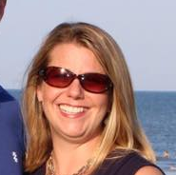

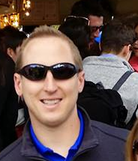
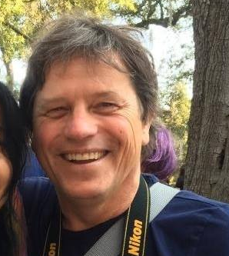

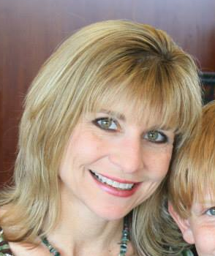
2019 SPOA Board Members
Elizabeth Driesen
Natasha Lee
Jeff Driesen
Ron Banik
Jim Anthony
MOVED: Wendy Ray

Slide 9
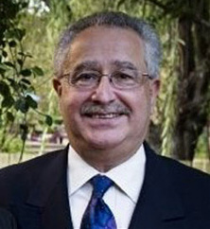
Neighborhood’s Part-Time Management Company
Professional Services Group (PSG) Ltd
Main functions are to:
  Manage neighborhood & SPOA finances
  Take the lead on answering initial calls for neighborhood issues
  Provide guidance on neighborhood issues
Robert Berman
stonecreek@psgltd.org
843-795-9751

Slide 10
Full-Time Management Company Potential
Estimates
Scope Statement:
  Regular review of the neighborhood (twice week)
  Identify, track, and act on issues (maintain tracker visible to Board Members)
  Finances
  Prep for annual meetings
  Host monthly meetings – invite neighbors
  Keep up tracker of email and mailing addresses
  Produce reports
  Work with vendors
  Receive complaints

Slide 11
Consistent Neighborhood Issues
Parking:
  Homeowners/residents must park in driveway or garage
  Guests can park on the street for no more than 12 hours without written consent from board
  No parking on sidewalks or on grass
Not getting Architectural Committee Review PRIOR to changing appearance of property (Roofs, fences, trees)
Yard Maintenance
  Need to keep yard trimmed
  Need to edge yard, and cut weeds around mailbox
House maintenance
  Pressure washing
  Trash and Recycling Cans MUST be hidden from street view
Notes:
Section 6. Debris. No debris, junk, wrecked or inoperable vehicles or similar unsightly items shall be allowed to remain on any lot.”
“No vehicle of any kind which is inoperable for a period of excess of twenty four (24) hours shall be permitted on the Properties. There shall be no parking on the street except for guests for a temporary period of not more than twelve (12) hours. There shall be no parking on sidewalks or on the public grass strips between sidewalks and streets. The Association is hereby empowered to remove, at an Owner's expense, any inoperable vehicle which remains on the Properties after five days written notification to the Owner. ”
. No grass, weeds, underbrush or other similar vegetation shall be allowed to grow 31 or permitted on any improved or unimproved Lot which is more than six inches higher than the 32 ground level of the said Lot. The Association is hereby empowered to enter onto said Lot to 33 remedy such default and the owner of said Lot shall pay to the Association the costs of such 34 remedying

Slide 12
SPOA Increase in Annual Dues
2019: $215
2020: $237, 10% increase
Justification:
  Additional cost for PSG support
  Continued pond fountain pump replacements
  Ensure a prudent financial reserve

Slide 13
SPOA Neighborhood Issue Reporting & Resolution Process
    If you see a need, email or call PSG
    PSG will address issue
    If after 10 days you continue to see an issue, contact PSG again
Any neighbor can report an issue to PSG
stonecreek@psgltd.org, 843-795-9751

Slide 14
Neighbor Comments
    5G Issues
    School traffic issues

Slide 15
Back-Up

Slide 16
2019 Neighborhood Budget Summary
Total Budgeted Annual Expenses : $20,000
Total Budgeted Annual Income: $23,650
Based on 110 Homes @ $215
Budgeted Positive Net Income : $3,650
Projected year end Net Income $3,650
Projected year-end dues not paid $7,792 (18% of houses)
Projected year-end reserve amount $24,000

Slide 17
SPOA Fine Schedule
Homeowner (and renters when applicable) receives first notice
If not addressed, homeowner receives second notice 10 days later
If still not addressed, homeowner receives third notice 10 days later via certified mail and is charged a fine per the fine schedule.
If the homeowner does not address the issue within 30 days after the third notice, he/she will be fined a second time of the same amount. This will continue (30 days, fine, 30 days, fine) if the issue is not addressed
When the homeowner accrues fines of $500 there will be a lien placed on the home
If you receive a notice, and are unable to take care of the issue, or have questions about it, contact PSG

Slide 18
SPOA Fine Schedule (cont.)
    $100/Incident: Homeowner maintenance needed (yard, power washing, etc.)
    $100/Vehicle: Parking on the street, grass, sidewalk
    $175/Nuisance/Noise: Barking dogs, loud noises, etc.
    $200+$10/day: Parking of boats in front of homes and/or on street
    $150: Not following Architecture Review Board (ARB) + potential cost to alter the revision back to original
    Any home owing more than $500 will have lien placed on home

